Slide 1
Data Structures and Algorithms

Slide 2
Chapter Four
Stack

Slide 3
Chapter contents
Properties of Stack
Array Implementation of Stack
Linked List Implementation of Stack
Application of Stack
Infix to Post fix (RPN) conversion
Evaluation of Algebraic Expression
Function calls

Slide 4
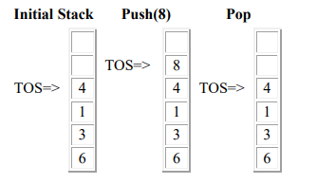
Stack
A stack is a simple data structure, in which insertion and deletion occur at the same end.
It is a LIFO (Last In First Out) structure. The operations of insertion and deletion are called PUSH and POP.
Push - push (put) item onto stack
Pop - pop (get) item from stack
Implementation: Stacks can be implemented both as an array and as a linked list.

Slide 5
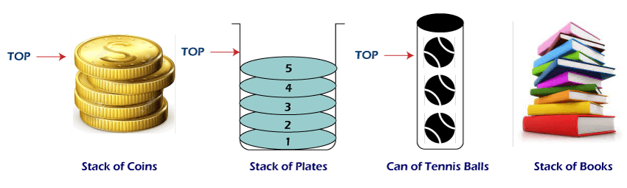

Slide 6
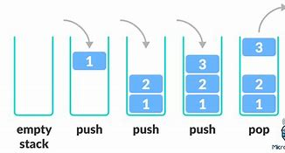
Array Implementation of Stacks
The PUSH operation is addition of an element to a stack.
So, if an array is given to you, which is supposed to act as a STACK, you know that it has to be a STATIC Stack; meaning, data will overflow if you cross the upper limit of the array.

Slide 7
Array Implementation of Stacks
void stack[UPPERLIMIT];
int top= -1; //stack is empty
Void push(int item){
top = top + 1;
if(top < UPPERLIMIT)
stack[top] = item;
else
cout<<"Stack Overflow";
}
Int main(){
push(item);
}

Slide 8
Cont..
The POP operation is the synonym for delete when it comes to Stack.
So, if you're taking an array as the stack, remember that you'll return an error message, "Stack underflow", if an attempt is made to Pop an item from an empty Stack.

Slide 9
Cont..
Void stack[UPPPERLIMIT];
int top=-1;
int pop(){
int del_val;
if(top == -1)
cout<<"Stack underflow";
else {
del_val = stack[top];
stack[top] = NULL;
top = top -1;
}
return(del_val);
}
Int main(){
pop();
}

Slide 10
Linked List Implementation of Stacks
The PUSH operation is very similar to the insertion operation in a dynamic singly linked list.
The only difference is that here you'll add the new element only at the end of the list, which means addition can happen only from the TOP.
Since a dynamic list is used for the stack, the Stack is also dynamic, means it has no prior upper limit set.
So, we don't have to check for the Overflow condition at all!

Slide 11
Cont..
struct node{
int item;
struct node *next;
}
node *stack = NULL;
Void push(int item) {
node *newnode = new node;
newnode -> item = item;
newnode -> next = NULL;
if(stack == NULL) {
stack = newnode;
}
else {
newnode ->next = stack;
stack= newnode;
}
}
Int main(){
push(item);
}

Slide 12
Cont..
This is again very similar to the deletion operation in any Linked List, but you can only delete from the end (last entered) of the list and only one at a time; and that makes it a stack.
Here, we'll have a list pointer, "target", which will be pointing to the last entered element in the List (stack).
Every time we POP, the TOP most element will be deleted .

Slide 13
Cont..
struct node{
int nodeval;
node *next;
};
node *stack= NULL;
Void pop( ){
int pop_val = 0;
node *target = stack;
if(stack == NULL)
cout<<"Stack Underflow";
else {
node *target=stack;
stack=stack->next;
delete target;
}
}

Slide 14
Applications of stack
Infix to Post fix (RPN) conversion
Infix notation:
Operators are written between the operands they act on;
e.g., “2+2”.
Parentheses surrounding groups of operands and operators are used to indicate the intended order in which operations are to be performed.
In the absence of parentheses, precedence rules determine the order of operations.
E.g., Because “-” has lower precedence than “*”, the infix expression “3-4*5” is evaluated as “3-(4*5)”, not as “(3-4)*5”. If you want it to evaluate the second way, you need to parenthesize.

Slide 15
Cont..
Postfix notation (a.k.a. Reverse Polish Notation (RPN))
Operators follow their operands, e.g., adding three and four is written as “3 4 +” rather than “3+4”.
If there are multiple operations, the operator is given immediately after its second operand; so the expression written “3 - 4 + 5” in infix notation would be written “3 4 - 5 +” in RPN: first subtract 4 from 3, then add 5 to that.

Slide 16
Cont..
Advantage of Postfix Notation
The postfix notation obviates the need for parentheses that are required by infix.
With infix notation, “3-4*5” can be written as “3-(4*5)”, that means something quite different from “(3-4)*5”.
In postfix, the former is written as “3 4 5 * -”, which unambiguously means “3 (4 5 *) –”, and the latter is written as “3 4 – 5 *”, which unambiguously means “(3 4 -) 5 *”.
Postfix notation is easier to parse by computer than infix notation, but many programming languages use infix due to its familiarity.

Slide 17
Infix to Post fix (RPN) conversion
Evaluating infix expressions is non-trivial for several reasons:
Operators have different precedences: ( ) > ^ > * = % = / > + = –
Some operators are left associative: +, –, /, %
One operator is right associative: ^
For example, expression 4 + 3 * 2 / 2 - 1 is evaluated as: 4 3 2 * 2 / + 1 -

Slide 18
2. Evaluating Postfix Expressions
Interpreters of RPN are often stack-based.
General idea:
Operands are pushed onto a stack, and when an operation is performed, its operands are popped from a stack and its result pushed back on.
At the end, the value of the postfix expression is on the top of the stack.
Since all the needed stack operations take constant time, and the evaluation algorithm is quite simple, RPN expressions can be evaluated quickly and easily.
We start with an empty stack and scan the postfix expression from left to right.
If the next item is a number, push it onto the stack.
If the next item is an operator, Op, do the following:
Pop two items right and left off the stack.
Evaluate (left Op right) and push the value back onto the stack.
When we reach the end of the expression, we pop off the single remaining from the stack. This is the value of the expression.

Slide 19
3. Function calls
What happens when a function is called?
If the function has formal parameters, they have to be initialized to the values passed as actual parameters.
In addition, the system has to know where to resume execution of the program after the function has finished.
The function can be called by other functions or by the main program (the function main()).
The information indicating where it has been called from has to be remembered by the system.
This could be done by storing the return address in main memory in a place set aside for return addresses, but we do not know in advance how much space might be needed, and allocating too much space for that purpose alone is not efficient.

Slide 20
Cont..
For a function call, more information has to be stored than just a return address.
Therefore, dynamic allocation using the run-time stack is a much better solution.
The state of each function, including main(), is characterized by the contents of all local variables, by the values of the function’s parameters, and by the return address indicating where to restart in the calling function.
The data area containing all this information is called an activation record or a stack frame and is allocated on the run-time stack.
An activation record exists for as long as a function owning it is executing.
This record is a private pool of information for the function, a repository that stores all information necessary for its proper execution and how to return to where it was called from.

Slide 21
Cont..
Activation records usually have a short life span because they are dynamically allocated at function entry and de-allocated upon exiting.
Only the activation record of main() outlives every other activation record.
An activation record usually contains the following information:
Values for all parameters of the function,
Local variables,
The return address of the calling function
A dynamic link to the calling function’s activation record
The function’s return value if it is not void.

Slide 22
